Slide 1
Physical computing from Scratch using scratchClient – Advanced Control servos, LEDs and more from Scratch using RPi, Arduino, scratchClient
Hans de Jong & Gerhard Hepp
Workshop for the Pi And More and Maker Faire conferences
Need to be updated for Scratch 2

Slide 2
Before we start

Slide 3
If you do not roll over from the intermediate workshop …
If you are familiar with scratchClient, but not with the new config tool …
… you may want to look at some slides of the beginners workshop
Other than that, you do not have to build up the complete setup what the people of the beginners workshop did.
Only those things on the next slide.
You will however see the components of the beginners workshop in the diagrams.
Just ignore those.

Slide 4
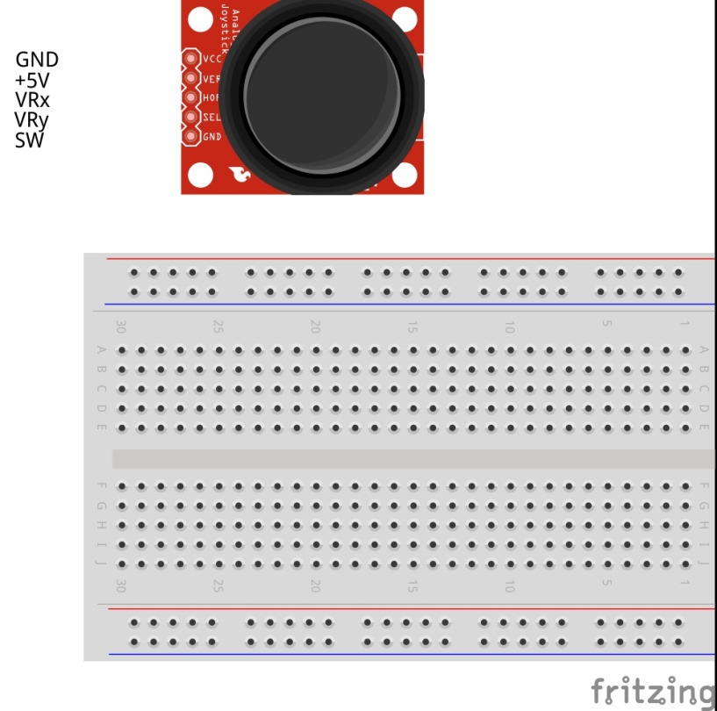
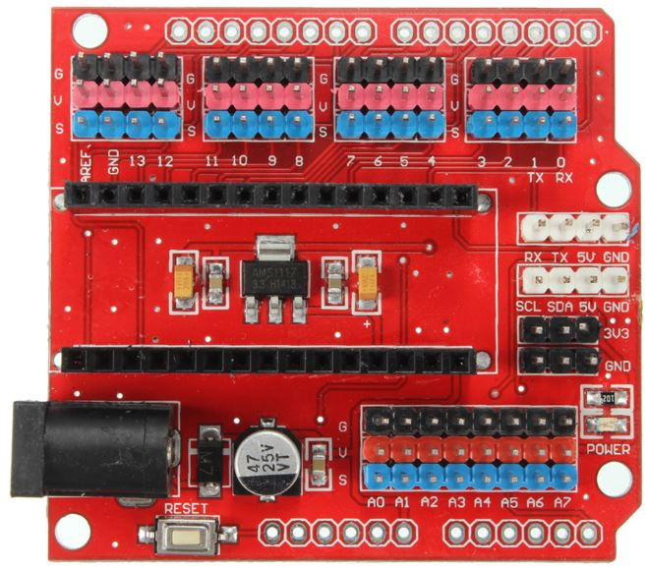
Connect the power wires
Only to be done if you did NOT continue from the beginners workshop

Slide 5
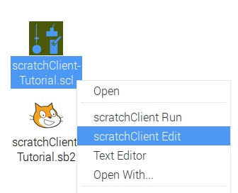
Make the config file for all steps
Open config file by right clicking and choose scratchClient Edit
In order not to loose time, it is recommended to add all setups in the config file now.
If you continued from the beginners workshop then leave in what you have, only add.
D3: out, pwm, 3Color Red LED
D5: out, pwm, 3Color Blue LED
D6: out, pwm, 3Color Green LED
D8: in, counter_pullup, Counter button
D10: in, counter, IR sensor
- A0: in, analog, Rain Sensor
- A1: in, input_pullup, Tilt Sensor
- A2: out, output, Relay
- A3: in, analog, Sound Sensor
- A5: in, input_pullup, Joystick Button
- A6: in, analog, JoyStickY
- A7: in, analog, JoyStickX

Slide 6
Choose the topics you want to give priority
(This) Advanced workshop
Joystick
Control position or control speed
Take care of calibration and drift
3-color LED
To make any color
Counter function
With button or IR slotted sensor
Rain sensor
Tilt sensor
Sound sensor
Expert workshop
Strongly link the config file to the Arduino
For safety
For connection errors
Control multiple Arduinos concurrently
Power On Self Test
Controlling a relay
Controlling 220 Volt appliances (only info)
Controlling a camera (only info)
The advanced workshop may be too short to do all activities.
So pick the order of the topics from the list
The red topics teach you more about scratchClient.
The green topics teach you more about electronics, sensors and engineering.
If you rather would do pieces of the beginners workshop then that is fine as well.

Slide 7
Part 1: Joy stick

Slide 8
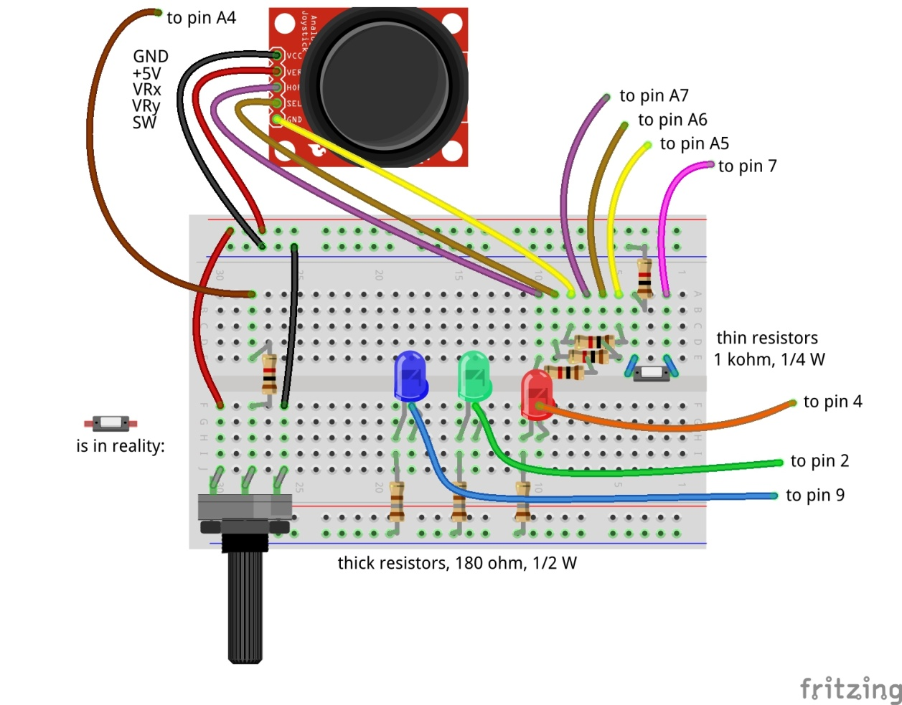

Adding the joy stick
X
Y
Don’t forget: take out USB and 9V cable before making changes!

Slide 9
Try it out
A joy stick has two small potentiometers and a button
When the joy stick is released (neutral position), the potentiometers are in the middle of the value range (middle between 0 and 1024)
There is one potentiometer for X and one for Y
The button is operated when pressing the button.
Reconnect and repower
Wait till the Arduino LED blinks slowly.
Now try moving and pressing the joy stick. Look at the 3 joy stick values to change
JoystickX and JoystickY between about 0 and about 1023.
Joystick Button between 0 and 1

Slide 10
Uses of Joysticks
You can directly use the value of the joystick
E.g. to control the position of a servo
E.g. to control the intensity of a LED
When releasing the knob, it will move back to the middle value.
E.g.: LED = JoystickX
You can alternatively use the joystick to determine the speed of the change
E.g. move a servo fast or slow. Let the servo stop at the latest position when you release the knob.
E.g.: LED = LED + (JoystickX – 512) / 200 (512 = neutral position value, 200 = sensitivity)
You can also use the Scratch pen function draw on the screen.
And e.g. use the potentiometer to change pen width or color.
Take care of drift and jitter (see next slide)

Slide 11
Take care of drift and jitter
Not all joysticks will give the same value if they are in the middle position
Influenced by temperature, the value produced in the middle position can drift over time.
Therefore build in some threshold around the middle position
If the middle position is 512, then do only react if the value changes by at least ca. 15, so e.g. > 525 or < 500.
Whether 15 is enough as threshold you will learn over time. Increase the value if it drifts more than that.
If you have a general program that works with several joysticks then you may have to use a larger threshold, or you need to calibrate (adapt the program for each particular servo).

Slide 12
Part 2: Control a 3-color LED
To make all colors

Slide 13
Control a 3-color LED
A 3-color LED has 3 LEDs in one package
Green
Red
Blue
Use PWM to change the intensity of each color
In that way you can create the entire spectrum of light
Including white light
Connect the 3-color LED carefully to the pins as defined in the config file.
Also connect the minus (–) pin to GND
Reconnect and repower
No need to restart scratchClient (since no update to the config file was made)
Give the corresponding variables in Scratch values between 0 and 100 with the slider on the variable.
Does it work?
We will see in the next slide how to use values between 0 and 255
Don’t forget: take out USB and 9V cable before making changes!

Slide 14
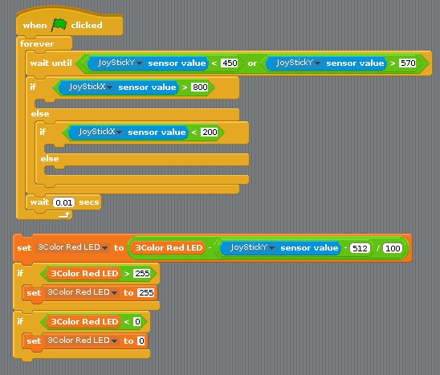
Connecting the 3-color LED to the joy stick (via Scratch)
Write a program in Scratch that:
Uses the value of the X direction of the joy stick to determine red, green or blue
Uses the value of the Y direction to change the intensity of the respective LED
When releasing the joy stick, the colors should stay
You will need these elements
Need to be updated for Scratch 2
You need this block 3 times for the 3 colors

Slide 15
Part 3: The new counting function

Slide 16
Why a special counting function?
You can count in Scratch, however you can only reliably count a few pulses per second.
With this new counting function, you can do it much faster
If you need to detect small pulses that scratchClient may not see reliable, you can use a counter function to detect whether a (short) pulse did arrive.

Slide 17
Counter function using a button
It will count up. It will wrap round at a very large value that will be reached after days of counting.
Max. ca. 80 counts per second = 4800 per minute
There is a 4 ms debouncing delay
So multiple pulses within 4 ms will processed as a single count
So no need for capacitors to do debouncing

Slide 18
Debouncing
If a mechanical switch is operated, it can generate a series of pulses rather than one.
This is because one of the metal pieces bounces back a few times before it stays in position.
You would normally need take care of this if you want to get a single pulse
E.g. add a capacitor.
scratchClient will on the digital input pins only sample with 10 Hz, so it is unlikely that you will experience bounce problems.

Slide 19
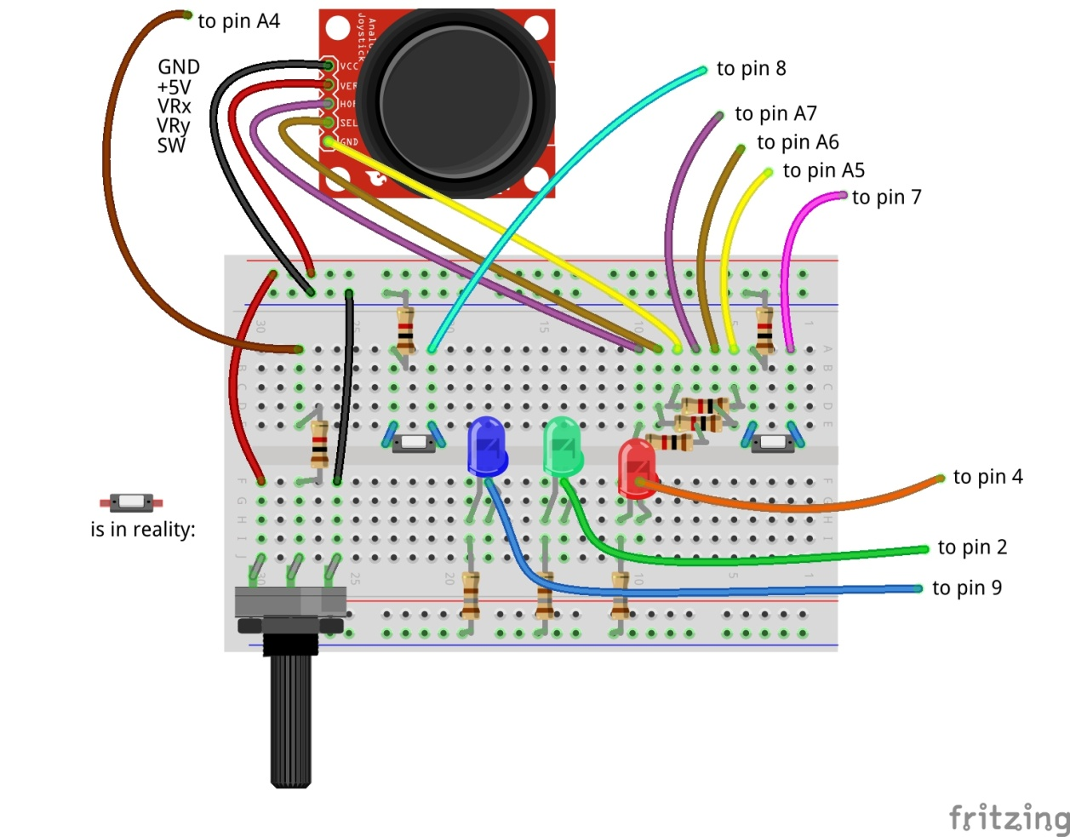
Adding the count button
Don’t forget: take out USB and 9V cable before making changes!

Slide 20
Adding an IR speed sensor that counts on pin 10
Carefully follow the wires to connect correctly!
Don’t forget: take out USB and 9V cable before making changes!

Slide 21
Differences between the counters
The IR sensor gives an output of 0 Volt or 5 Volt.
Therefore it does not need a pull up resistor (see the config file)
The button gives an output of 0 Volt or open.
Hence it needs a pull up resistor (as specified in the config file)

Slide 22
Try out the setup
The button you can just press.
The IR sensor you need to have good opaque material to let it work.
You can check the sensing by the LED at the backside.

Slide 23
Part 4: Tilt sensor

Slide 24
Tilt sensor
The tilt sensor is a sensor containing a rolling ball between contacts.
You can hear it rattling if you shake it.
It is not in the box. We only have a few, so you will need to share.

Slide 25
Connect the tilt sensor to pin A1
Carefully follow the wires to connect correctly!
Don’t forget: take out USB and 9V cable before making changes!

Slide 26
Part 5: Rain Sensor

Slide 27
Rain sensor
A rain sensor is an analog sensor that measures conductivity that is influenced by water.
It is not in the box. We only have a few, so you will need to share.

Slide 28
Connect the rain sensor to pin A0
Carefully follow the wires to connect correctly!
Don’t forget: take out USB and 9V cable before making changes!

Slide 29
Part 6: Sound sensor

Slide 30
Sound Sensor
The sound sensor will detect sound.
It is a digital sensor that contains a microphone and will give 0 Volt if sound is detected, 5 Volt if no sound detected.
It is not in the box. We only have a few, so you will need to share.

Slide 31
Connect the sound sensor to pin A3
Carefully follow the wires to connect correctly!
Don’t forget: power off and USB cable out before making changes!

Slide 32
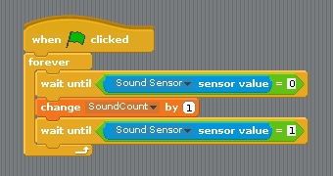
See the short pulses
The changes of the sound sensor are sometimes difficult to see just from the displayed sensor value
This code can be used to see that the sensor is actually working. You must create a variable SoundCount (or choose a different name) to hold the count.
Need to be updated for Scratch 2

Slide 33
The end of the Advanced Workshop

